Slide 1


Slide 2
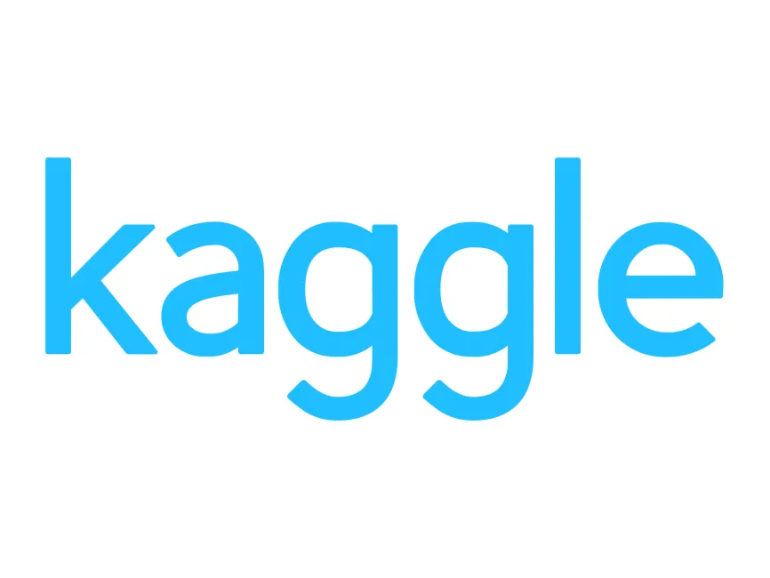

About our dataset/api
Our API is from Weatherstack, which provides real-time weather data, including temperature, humidity, wind speed, and UV index.
It supports up to 1,000 API calls per month, which gave us some issues
Our Kaggle dataset contained global weather data with 41 different features, including country, temperature, humidity, and UV index.

Slide 3
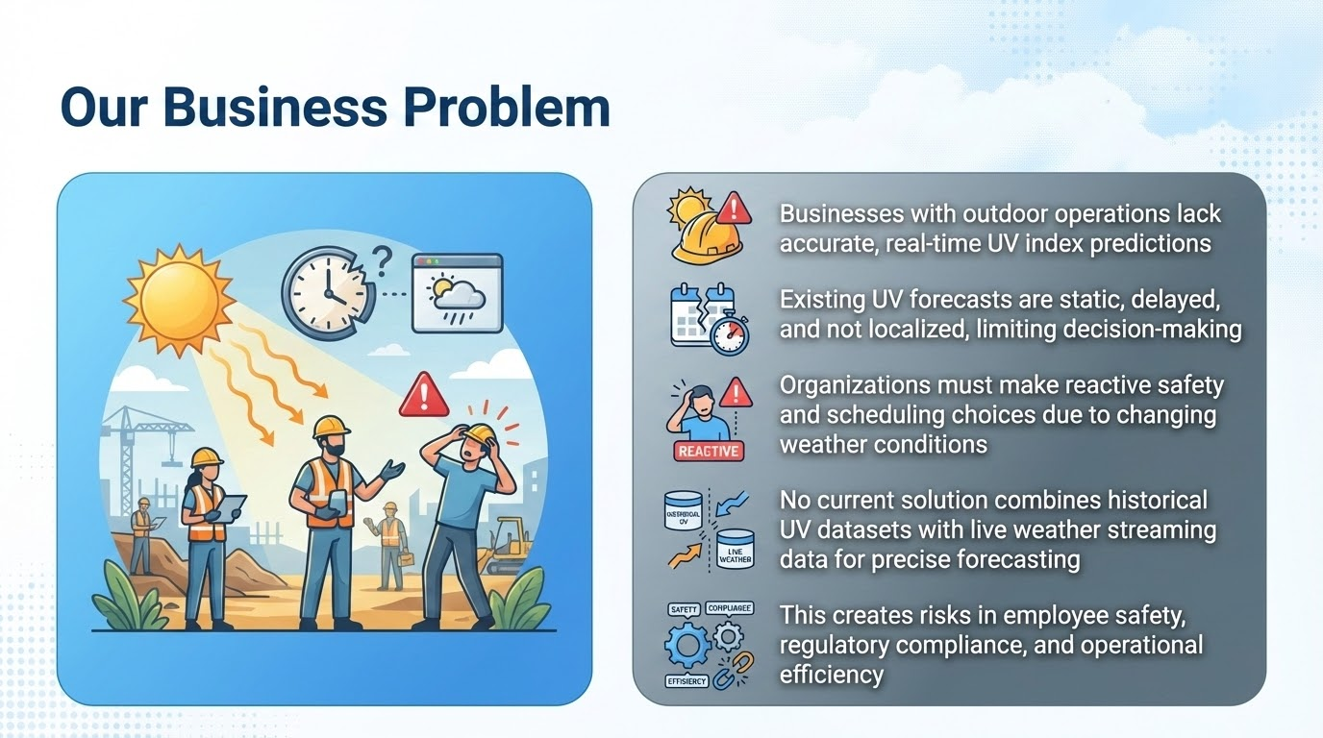

Slide 4
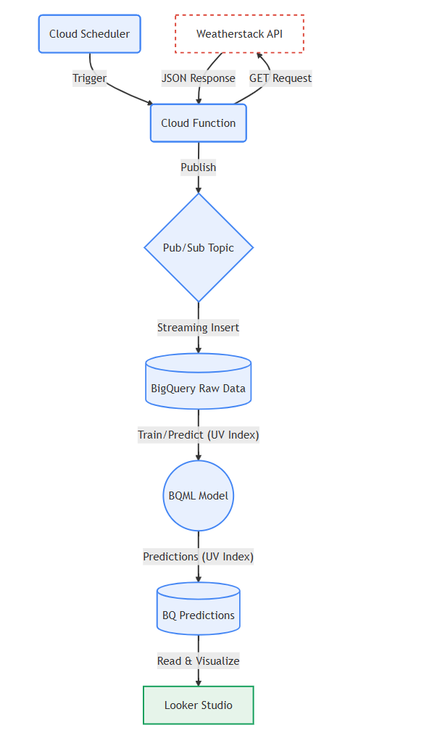
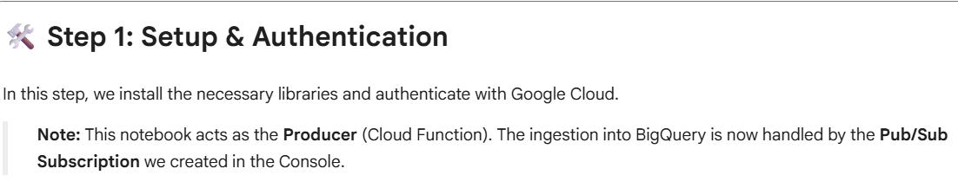
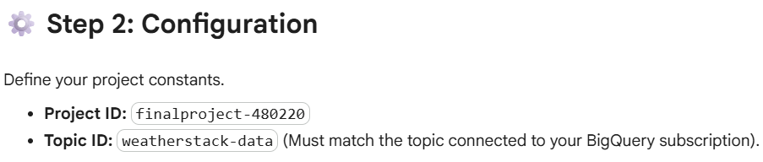
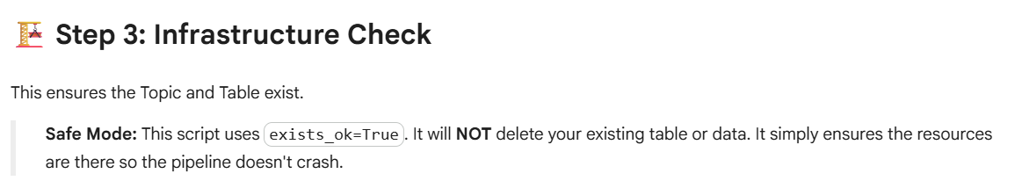
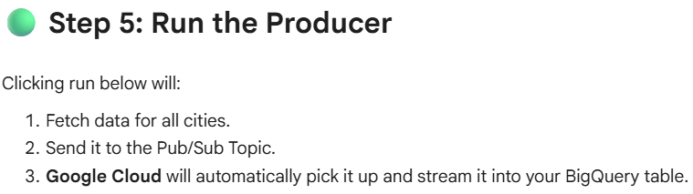
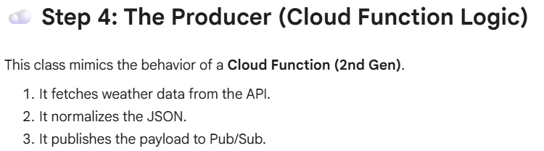
Pipeline Architecture

Slide 5
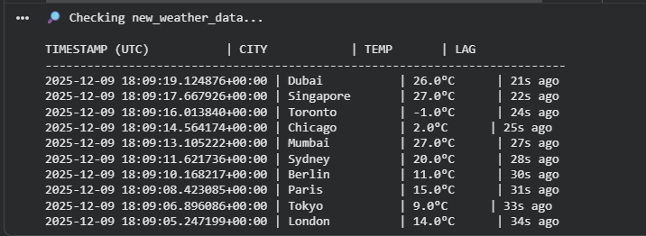
Pipeline proof

Slide 6
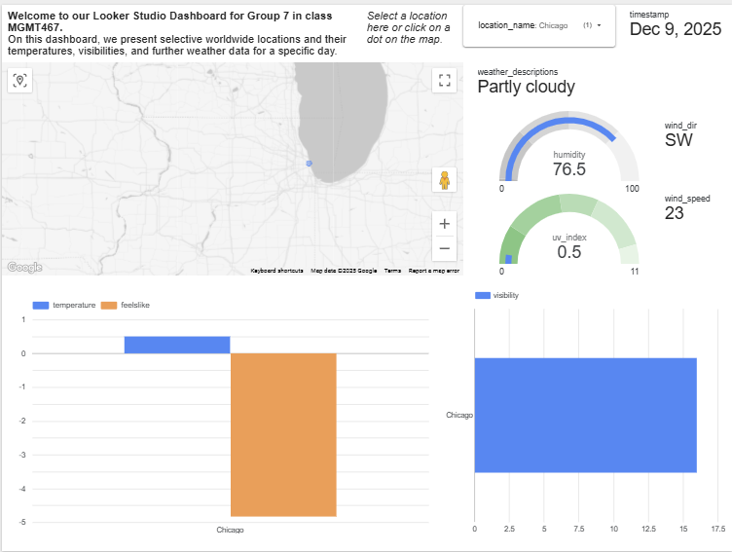
Dashboard

Slide 7
Model Development and Results
Combining Datasets
Model Selection
Training and Testing
As previously mentioned, we used 2 sources of data
Combined the kaggle data and weathercast data into one dataset
Used features from both datasets
Used a boosted tree regressor model
This model type ensures it eliminates extra noise from the data
Our target variable has non-linear relationships with other variables in the dataset
Our model performed at a higher level than expectations
Yielded an R^2 value of .89
MSE of the model was about 1.36

Slide 8
